Slide 1

Age of Learning Pilot Data Analysis
Student Engagement, Growth, and Usage Patterns
Nick Peralez - Senior Product Analyst Candidate
01/15/2025
Notes:
Good [morning/afternoon], everyone. My name is Nick Peralez, and I’m excited to share insights from the Age of Learning pilot program as part of my Senior Product Analyst interview. This presentation covers key findings from the pilot, focusing on engagement, skill growth, and actionable recommendations for district-wide implementation.

Slide 2

An Effective Digital Learning Resource Can Significantly Improve Motivation, Engagement, and Self-Confidence
—Dr. Leslie Ponciano
Notes:
Director, Research and Educational Partnerships, Age of Learning, Inc.; formerly Assistant Professor and Director of Early Childhood Education Master’s Program, Loyola Marymount University

Slide 3

Table of Contents
Overview of the Pilot
Program Usage
Skill Growth
Usage Patterns and Variability
Recommendations
Q&A
Proprietary and Confidential.
Notes:
We’ll begin with an overview of the pilot program, followed by an analysis of usage patterns and skill growth. We’ll explore variability in engagement, discuss outliers, and conclude with key recommendations and a summary.

Slide 4
Overview of the Pilot
Description of the Pilot
Duration: The pilot program ran for 20 weeks, allowing ample time to thoroughly assess its impact on Rincon School District participants.
Objective: To familiarize RSD students with My Math Academy and My Reading Academy—two AI-powered personalized learning tools aimed at boosting their readiness for grade-level standards.
Proprietary and Confidential.
Notes:
The pilot ran for 20 weeks with the Rincon School District. Its goal was to introduce My Math Academy and My Reading Academy—two AI-powered tools designed to improve grade-level readiness through personalized learning.

Slide 5
Overview of the Pilot
Process
Placement Mode: Students started with an adaptive placement phase designed to evaluate their existing knowledge and skill levels.
Gameplay: Following the placement phase, students moved into regular gameplay. Here, an AI-powered recommendation engine personalized learning activities to fit each student’s optimal learning zone.
Skill Mastery: Students engaged in activities aimed at mastering skills that aligned with grade-level standards, focusing on clear, measurable progress.
Key Stakeholders: The pilot served as a testbed for districts to evaluate the effectiveness of the program before considering a district-wide rollout.
Proprietary and Confidential.
Notes:
Students began with a placement phase to assess their baseline skills, followed by gameplay, where AI recommendations guided their learning.
This pilot allowed us to evaluate the program’s effectiveness as a potential district-wide solution.

Slide 6
Overview of the Pilot
Key Outcomes Monitored
Student Engagement: Usage patterns, active days, and time spent in the program.
Skill Growth: Progress in skill mastery within grade-level domains.
Insights for Improvement: Usage behaviors that contributed to success and variability among students.
Proprietary and Confidential.
Notes:
Key outcomes we monitored include student engagement, skill growth, and insights into behaviors that contributed to success. These data points shaped the findings and recommendations I’ll share today.

Slide 7

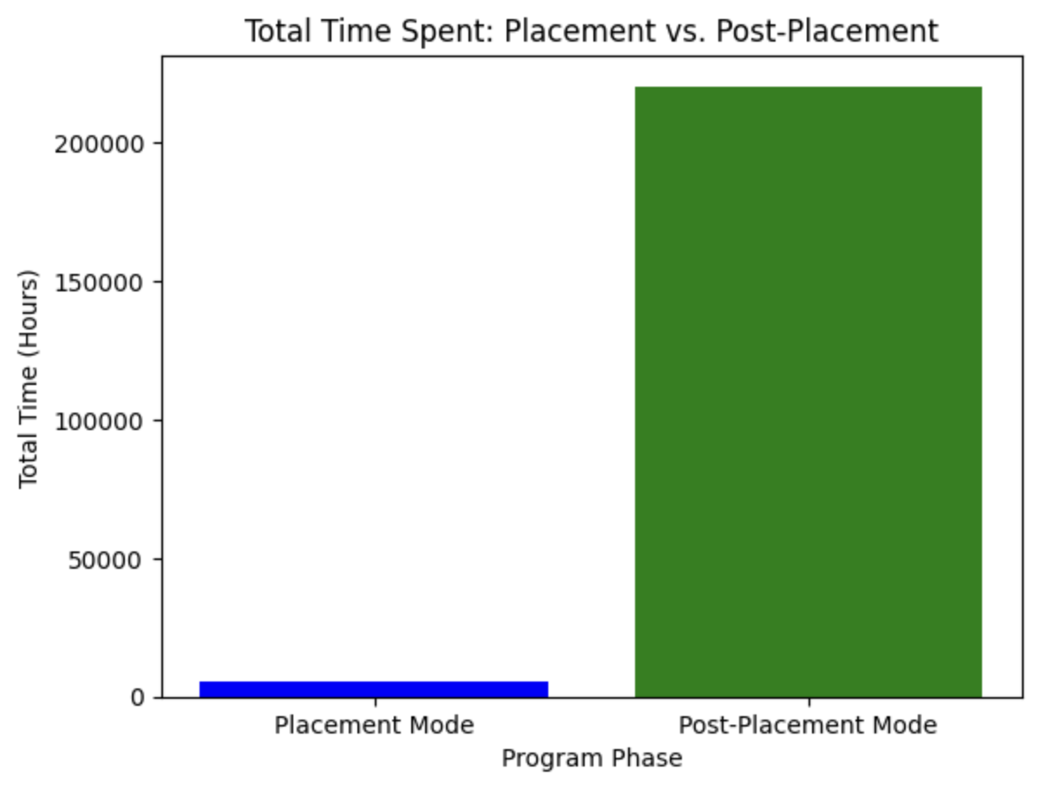
Program Usage - Overview
Proprietary and Confidential.
Notes:
This slide demonstrates the overall engagement levels during the pilot and shows how students transitioned into active gameplay.
Purpose:
To show the shift in time investment between the two key phases of the program.
What it Reveals:
Placement mode involves a smaller time investment (focused on assessment).
Post-placement mode accounts for the majority of student engagement, highlighting the program’s tailored learning activities.
Discussion Points:
If post-placement time is significantly higher, it suggests students remained engaged in the program beyond initial onboarding.

Slide 8
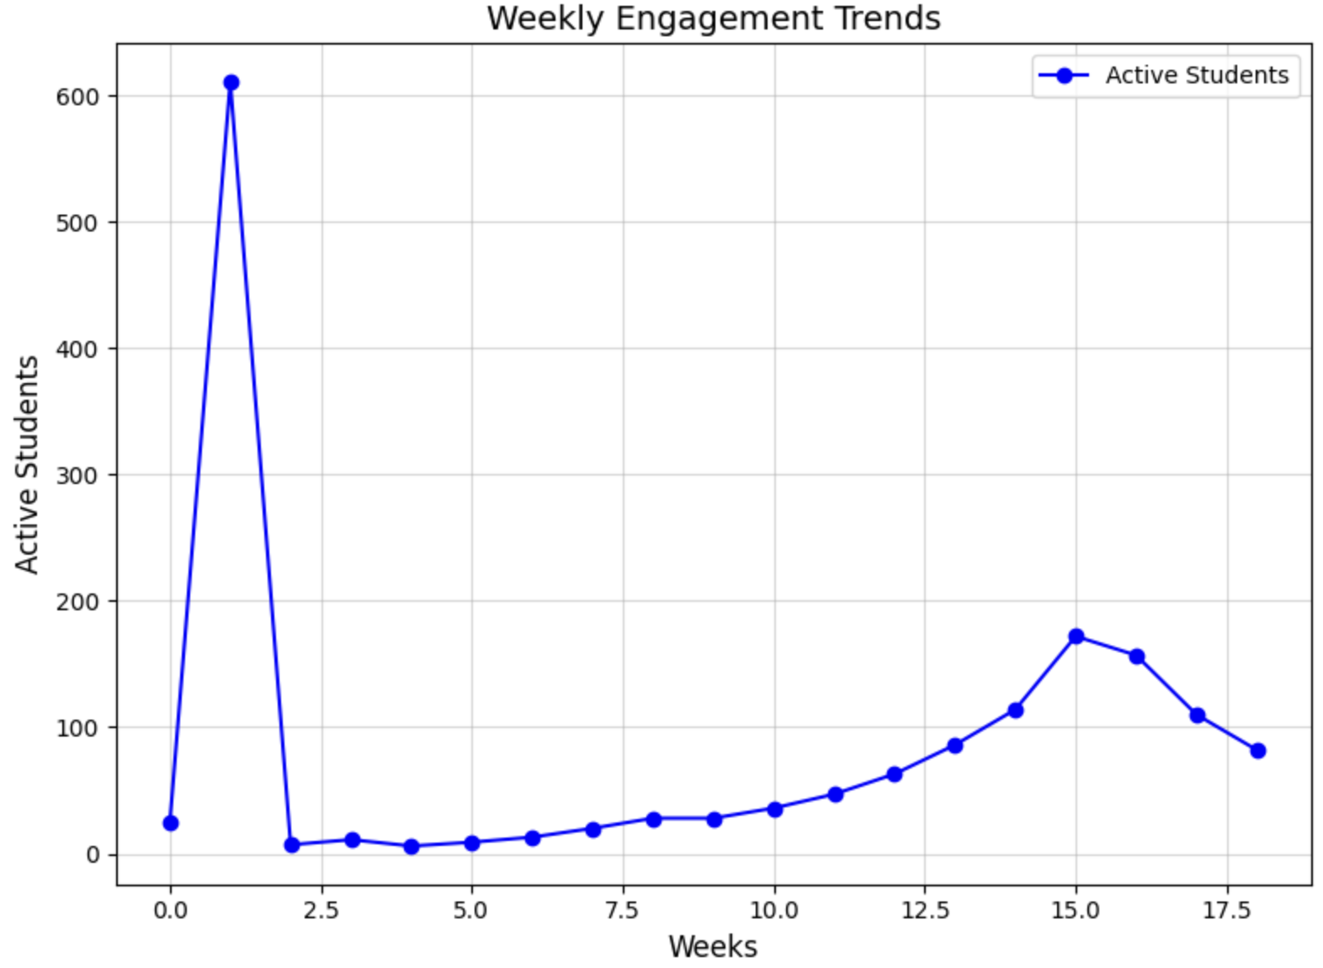
Program Usage - Trends
Proprietary and Confidential.
Notes:
Students engaged consistently throughout the pilot, with active participation in most weeks.

Slide 9
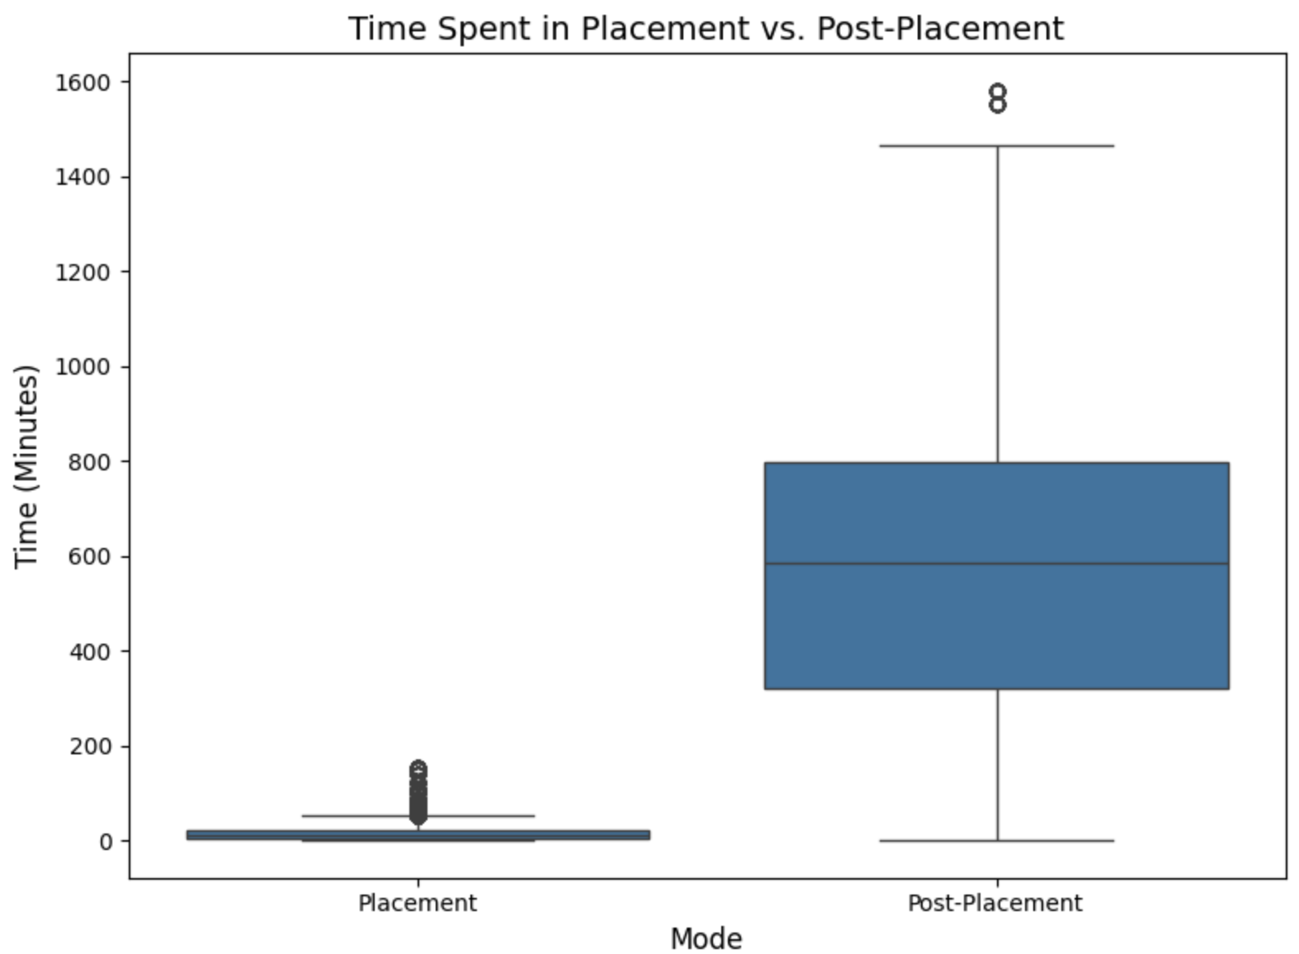
Program Usage - Trends
Proprietary and Confidential.
Notes:
Some variability suggests differing levels of commitment across the cohort.

Slide 10
Skill Growth - Overview
Total skills mastered: 796,213
Average percentage skill growth: 28.27%
Average Skills Mastered: 34.52
Total skill growth (mastered + passed): 488.73%
Proprietary and Confidential.
Notes:
The pilot program supported the mastery of 796,213 skills, with students demonstrating an average skill growth of 28.27%. Remarkably, when accounting for prior knowledge and gameplay, students achieved a total growth of 488%, far exceeding grade-level expectations.
These figures reflect meaningful progress across the cohort.

Slide 11
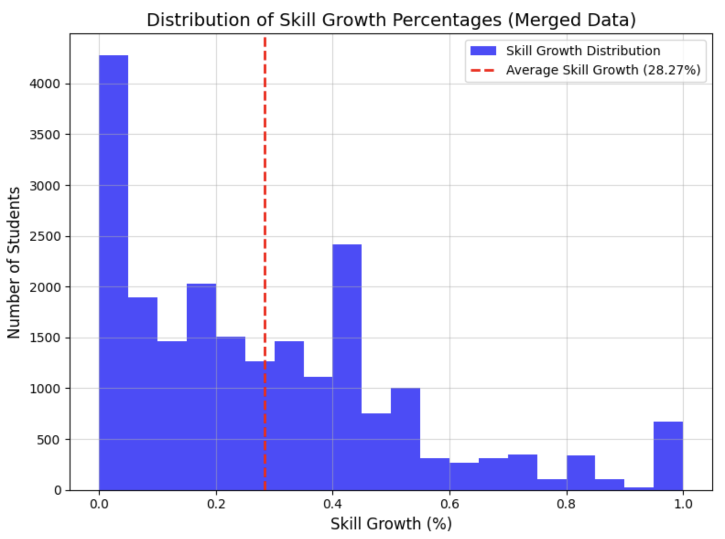
Skill Growth - Overview
Proprietary and Confidential.
Notes:
The histogram specifically visualizes growth percentages achieved during the program and helps validate the average growth value.

Slide 12
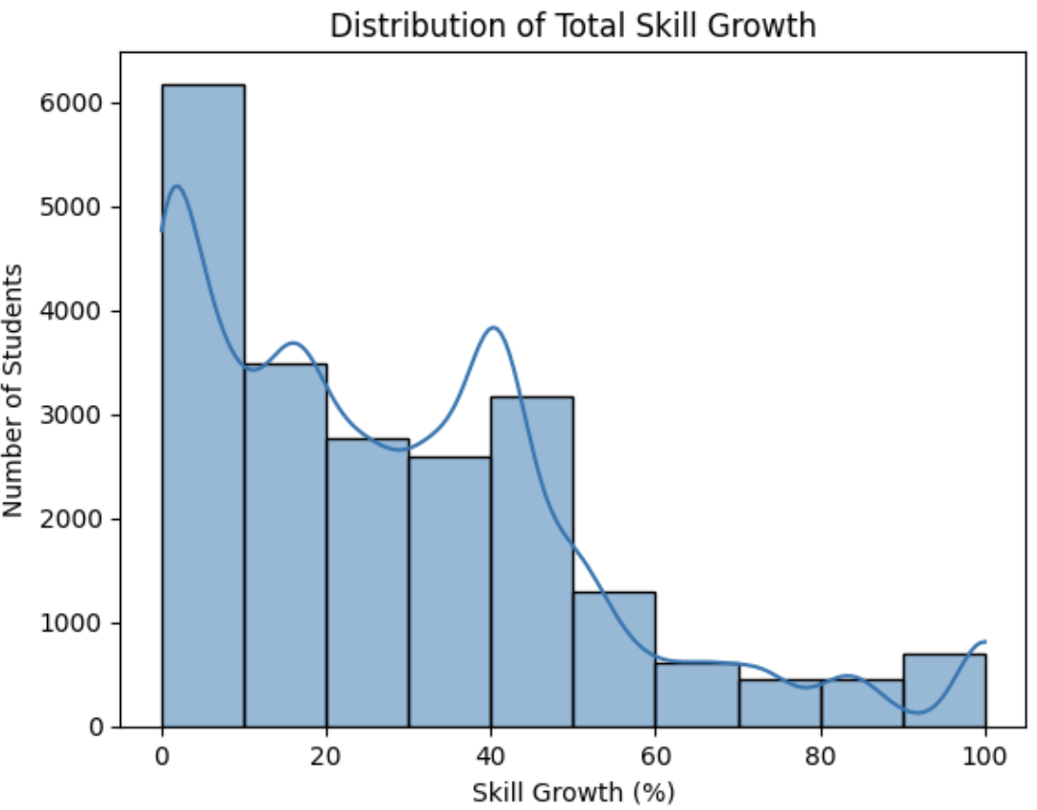
Skill Growth - Overview
Proprietary and Confidential.

Slide 13
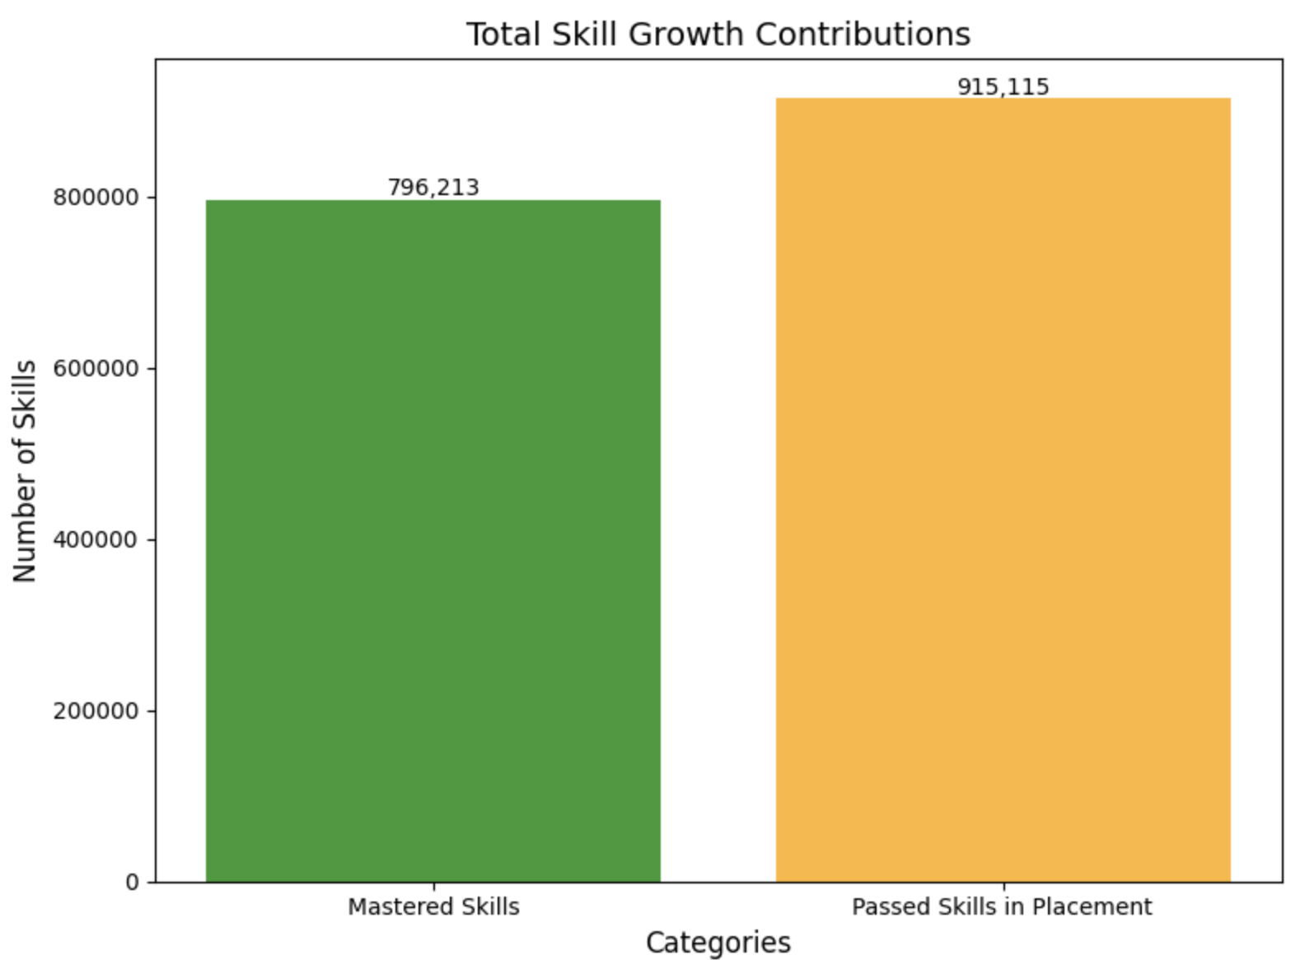
Skill Growth - Overview
Proprietary and Confidential.

Slide 14
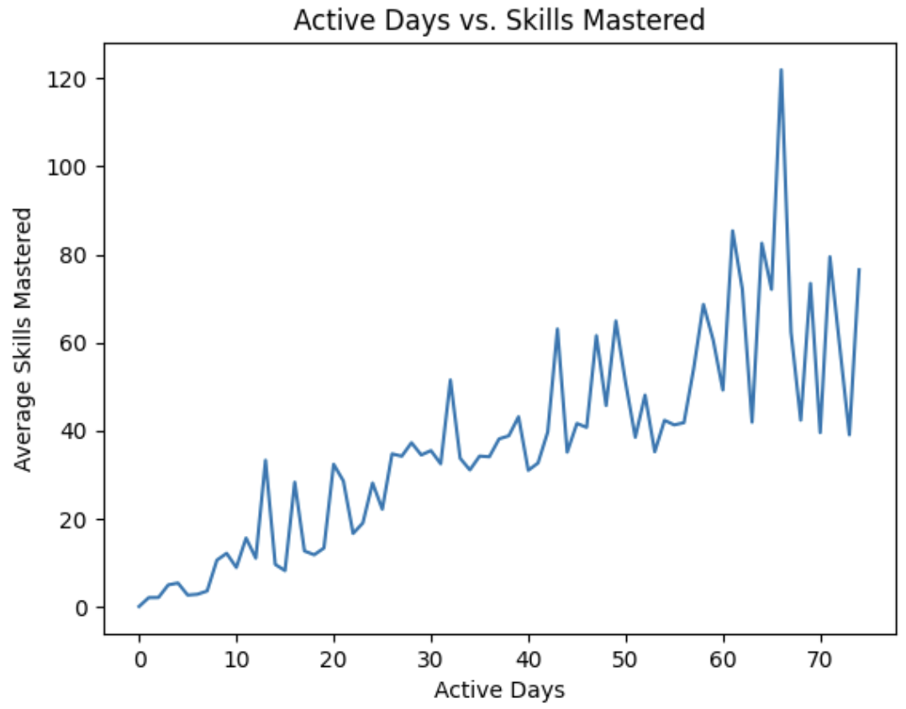
Skill Growth - Overview
Proprietary and Confidential.

Slide 15
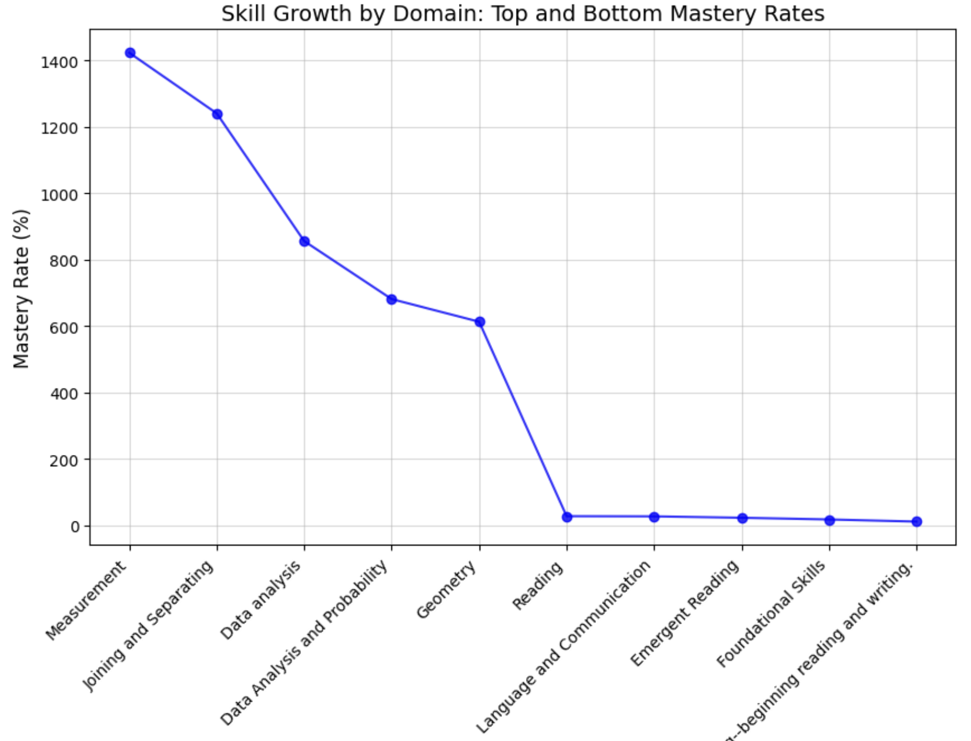
Skill Growth - Domain Insights
Proprietary and Confidential.
Notes:
Here we see that domains like Measurement and Joining and Separating achieved the highest mastery rates, while Foundational Language and Emergent Reading had lower rates.
These insights suggest a need to focus on refining curricula for lower-performing domains while leveraging strategies from high-performing ones.
Domain-level analysis reveals strengths in Measurement (1423.43%) and Joining and Separating (1240.91%), indicating exceptional student performance in these areas. Conversely, opportunities for improvement are evident in domains such as Developing and Sustaining Foundational Language (11.79%) and Foundational Skills (18.14%), where mastery rates are significantly lower.
DOMAIN
Measurement 1423.427673
Joining and Separating 1240.909091
Data analysis 856.331169
Data Analysis and Probability 681.666667
Geometry 613.500000
Reading 28.034343
Language and Communication 27.524631
Emergent Reading 23.303152
Foundational Skills 18.142746
Developing and sustaining foundational language... 11.785336

Slide 16
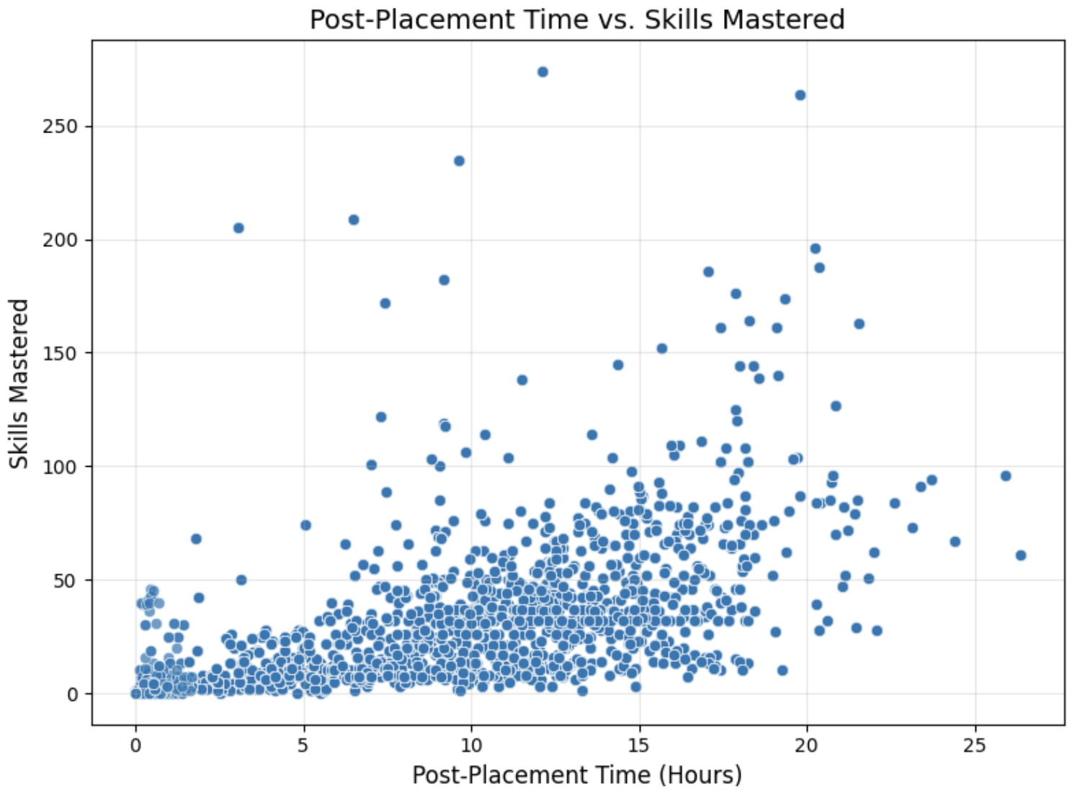
Usage Patterns and Correlations
Proprietary and Confidential.
Notes:
Correlations reveal that consistent usage and targeted time investment are key drivers of skill mastery.

Slide 17
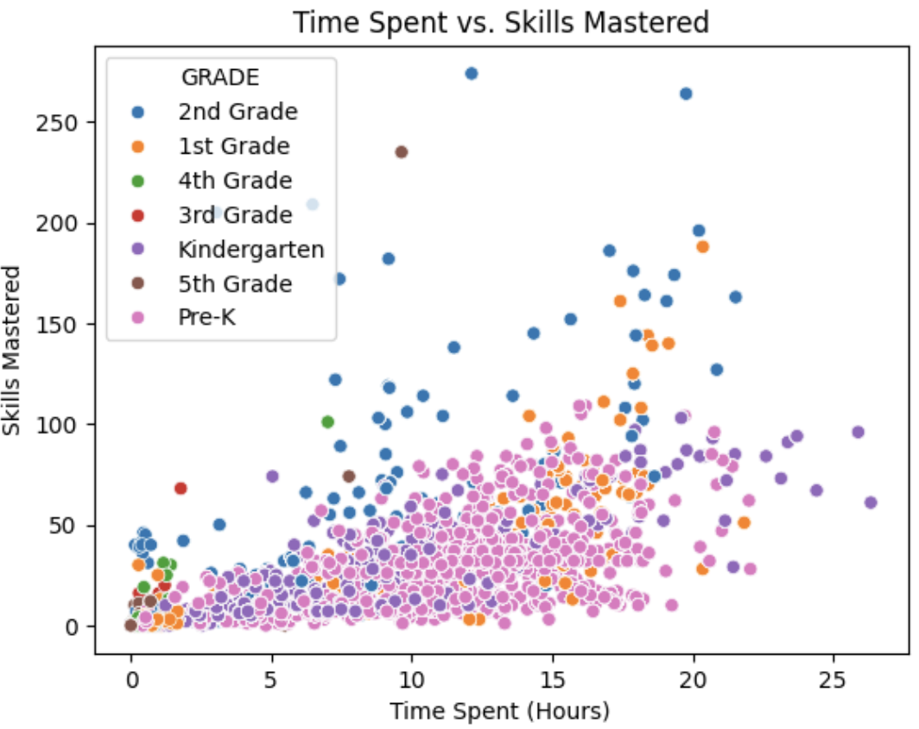
Usage Patterns and Correlations
Proprietary and Confidential.
Notes:
Correlations reveal that consistent usage and targeted time investment are key drivers of skill mastery.

Slide 18
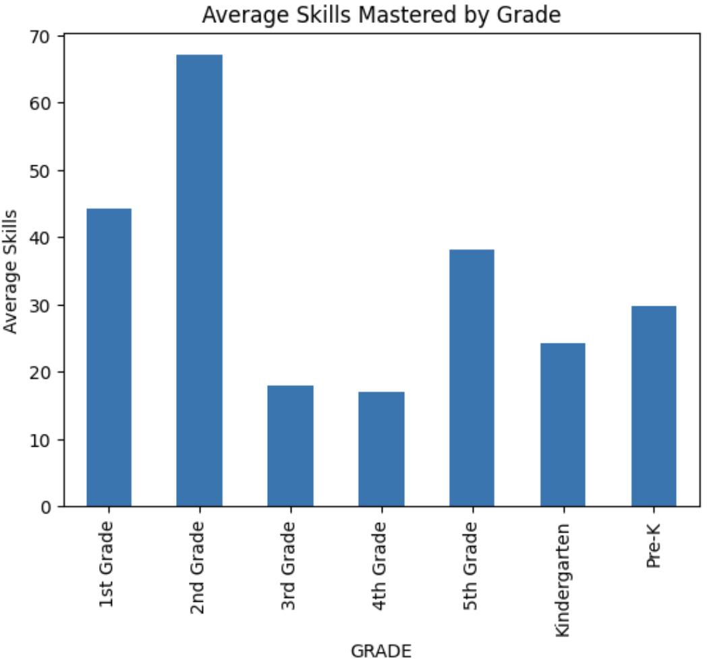
Usage Patterns and Correlations
Proprietary and Confidential.
Notes:
Skill mastery varies significantly by grade, with 1st and 2nd graders mastering the most skills on average. This suggests higher engagement or effectiveness of the curriculum at these grade levels, while lower averages in 3rd and 4th grades highlight potential areas for further investigation.

Slide 19
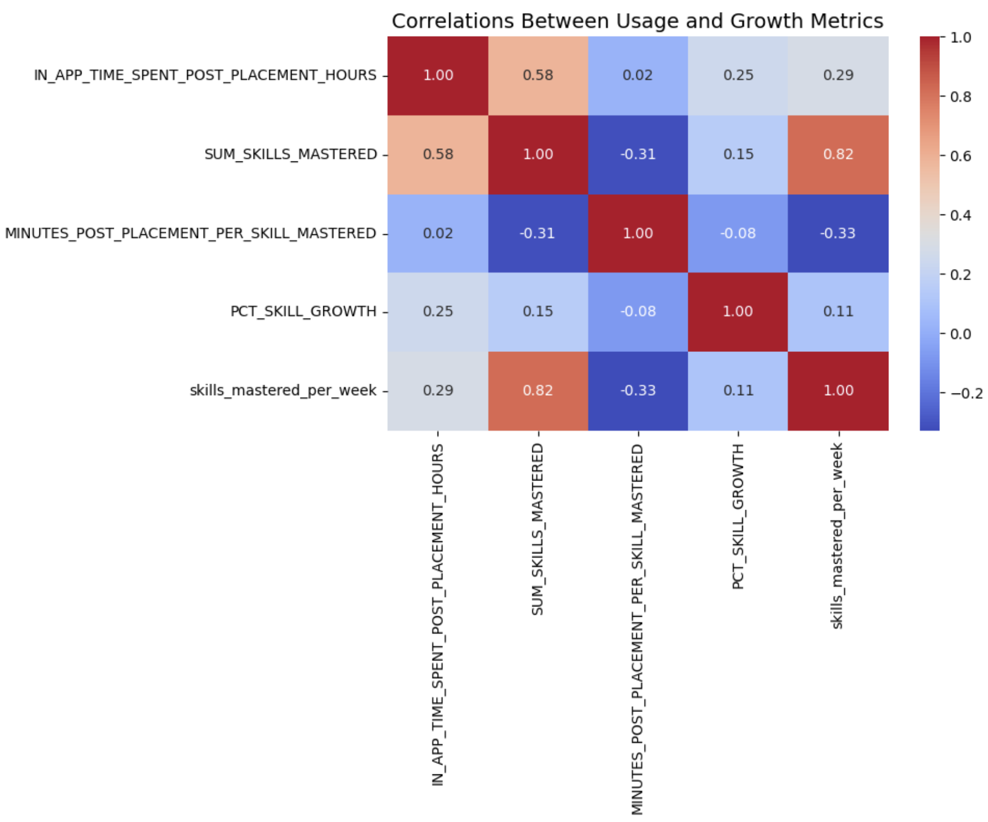
Usage Patterns and Correlations
Proprietary and Confidential.
Notes:
A heatmap analysis revealed that higher post-placement time correlates with skill mastery, but efficiency (skills mastered per week) is a stronger driver of success.
1. Consistency and Targeted Investment Work:
Students who spend more time post-placement and engage efficiently (mastering skills quickly) achieve better outcomes.
2. Time Investment Alone Is Not Enough:
Students who are less efficient in their use of time (spending many minutes per skill) do not perform as well in terms of total mastery.
3. Efficient Engagement Drives Results:
The strong correlation between total skills mastered and skills mastered per week shows that efficiency is a key driver of success This suggests that targeted engagement, rather than just time investment, is key to improving outcomes.
.

Slide 20
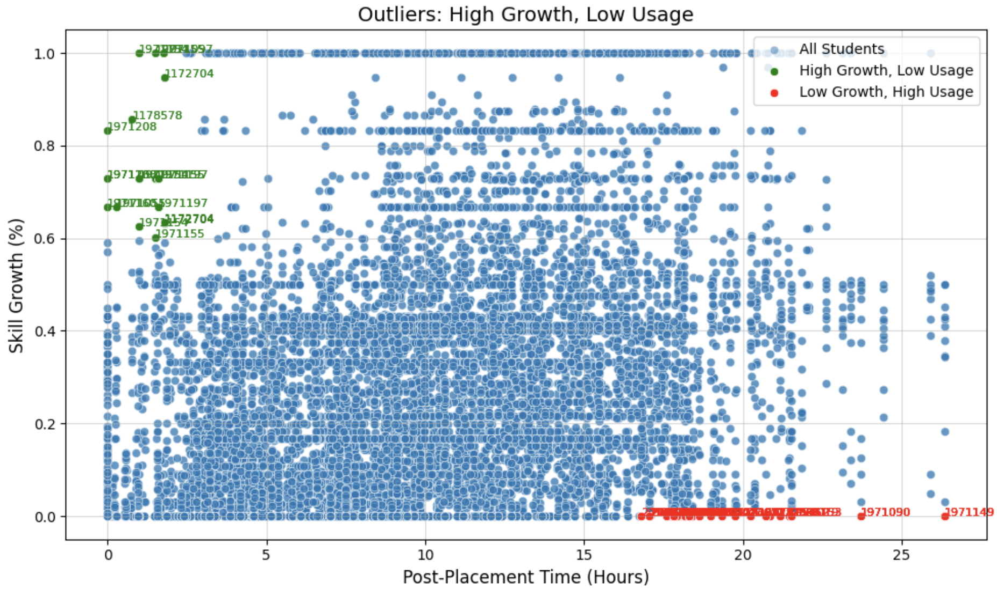
Outliers and Insights
Proprietary and Confidential.
Notes:
We identified two notable groups of outliers: students with high growth but low usage, and students with low growth despite high usage. High-growth, low-usage students highlight the program’s adaptability, while low-growth, high-usage students indicate areas where additional support or curriculum adjustments are needed.
Insights from the Plot
1. Efficient Learners (Green Dots):
These students represent success stories of the program. They achieve high skill growth with minimal time investment, demonstrating either high efficiency or strong initial knowledge.
2. Struggling Students (Red Dots):
Despite significant time spent in the program, these students show low growth. This group requires further support, either through targeted interventions or revised content delivery.
3. General Trend:
While more time post-placement correlates with skill growth to an extent, there is significant variability, indicating other factors (e.g., engagement quality or prior knowledge) play an important role.

Slide 21

Key Recommendations
Increase Post-Placement Engagement:
Encourage students to log in weekly to maintain steady growth and build strong learning habits.
Use gentle reminders or offer small incentives to keep participation consistent, especially during the post-placement phase, where sustained effort is closely linked to mastering skills.
Proprietary and Confidential.
Notes:
Increase Post-Placement Engagement:
Encourage weekly logins and provide incentives to maintain participation, especially in the post-placement phase.

Slide 22

Key Recommendations
Focus on High-Impact Domains:
Focus on improving areas where mastery rates are lower, such as foundational language skills and emergent reading.
At the same time, analyze high-performing areas like Measurement and Joining and Separating to identify successful strategies that can be applied across the curriculum.
Proprietary and Confidential.
Notes:
Focus on High-Impact Domains:
Refine curricula in foundational language skills and emergent reading while replicating successful strategies from high-performing areas.

Slide 23

Key Recommendations
Support and Learn from Outliers:
Provide extra help to students showing minimal progress despite high engagement, addressing any mismatches between their needs and the program’s content.
Highlight success stories from students achieving significant growth with minimal usage to uncover best practices and strategies that can benefit the entire group.
Proprietary and Confidential.
Notes:
Monitor Outliers:
Support low-growth, high-usage students to address engagement inefficiencies, and leverage insights from high-growth, low-usage students to inform program improvements.

Slide 24
Conclusion
Recap the Program’s Successes:
Strong Engagement:
Throughout the pilot, consistent weekly logins and active participation were a hallmark of the program’s success. High-performing students showcased how balanced engagement can yield impressive outcomes.
Meaningful Skill Growth:
The majority of students demonstrated noticeable growth in their skills, with exceptional progress seen in areas like Measurement and Joining and Separating. The program proved its ability to accommodate a variety of learning styles effectively.
Proprietary and Confidential.
Notes:
To summarize, this pilot demonstrated strong engagement and meaningful skill growth. High-performing students showcased how the program can yield impressive results with balanced participation.
We identified key engagement patterns that drive success and opportunities to address areas of improvement.

Slide 25
Slide 11: Conclusion
Patterns and Opportunities:
The pilot revealed important engagement patterns that contribute to success, such as maintaining weekly consistency and focusing on targeted time investments. At the same time, it shed light on areas that need attention, like supporting lower-performing skill domains and addressing cases where high usage didn’t translate to significant growth.
Reiterate the Program’s Potential:
The results clearly show that this program holds immense promise for enhancing student outcomes and bridging learning gaps. With a few strategic refinements, it’s poised for successful implementation at the district level.
Proprietary and Confidential.
Notes:
With strategic refinements, the program is poised for district-wide rollout and has significant potential to enhance student outcomes.

Slide 26
Q&A
Q&A
Proprietary and Confidential.
Notes:
“Are there specific areas you’d like me to elaborate on?”
“Do you see these insights aligning with the district’s goals?”

Slide 27
(End)
Proprietary and Confidential.
Notes:
Domain-level analysis reveals strengths in [specific domain] and opportunities for improvement in [another domain].

